Slide 1


K.RAMAKRISHNAN COLLEGE OF TECHNOLOGY
(AUTONOMOUS), TRICHY
MULTIPLE DISEASE PREDICTION
USING STREAMLIT
PRESENTED BY
811721104007- Abinesh A
811721104020- Celsi jaya sreejha P
811721104022- Chinrasu S
811721104038- Janarthanan S
Guided by
Mr. A. Malarmannan, B.E., M.E.
Date:04/06/2024

Slide 2
PRESENTATION OVERVIEW
Problem Identification
Objective
Abstract
Existing system
Disadvantages of existing system
Proposed system
Block diagram of proposed system
Explanation of proposed system
Advantages of proposed system
Results and Discussion
Snapshot of hardware results
Conclusion

Slide 3
PROBLEM IDENTIFICATION
Healthcare is increasingly leveraging technology to improve patient outcomes. Predicting diseases early can significantly enhance patient care, reduce healthcare costs, and save lives.
The current landscape of healthcare analysis using machine learning often focuses on individual diseases. This necessitates separate analyses for each condition, which can be Time consuming, Inconvenient, Limited Scope.
Machine learning models have proven effective in disease prediction by analyzing patient data and identifying patterns indicative of various conditions.

Slide 4
OBJECTIVE
The ultimate objective of the project is to develop a comprehensive, user-friendly web application capable of accurately predicting multiple diseases from patient data using machine learning techniques.
This application, built with the “Streamlit” framework, to provide healthcare professionals and patients with a reliable tool for early diagnosis and personalized health management.
The project should integrate machine learning models capable of analyzing the input data and providing accurate predictions for several diseases.

Slide 5
ABSTRACT
The project aims to develop a comprehensive web application that leverages machine learning algorithms to predict multiple diseases based on user inputs.
The application utilizes Streamlit, a powerful and user-friendly framework for creating interactive web applications in Python.
By integrating various machine learning models trained on diverse datasets, the system can analyze symptoms, demographic data, and medical history to provide users with accurate and timely disease predictions.

Slide 6
LITERATURE SURVEY
S.NO | JOURNAL NAME &YEAR | AUTHOR NAME | TITLE | METHODOLOGY | MERITS | DEMERITS
01 | Journal of medical systems, 2020 | Li, X., Wang, J., and Zhang, Y. | An Intelligent Healthcare System for Automated Disease Diagnosis Using Machine Learning | SVM, Decision Trees, and Neural Networks to analyze patient data and provide diagnoses. | The system demonstrated high accuracy and efficiency in diagnosing multiple diseases with real-time data input and processing. | Limited by the quality and volume of the training data, which may affect the system's performance in real-world scenarios.
02 | IEEE Acess, 2021 | Kumar, A., Gupta, R., and Mehta, P. | Machine Learning-Based Predictive Analytics for Multiple Disease Diagnosis | Random Forest and Gradient Boosting. The platform was deployed using Streamlit for interactive visualization and user interface. | High prediction accuracy and user-friendly interface with interactive visualizations and real-time updates. | Computationally intensive, requiring significant processing power, which could limit accessibility in resource-constrained settings.

Slide 7
LITERATURE SURVEY
S.NO | JOURNAL NAME &YEAR | AUTHOR NAME | TITLE | METHODOLOGY | MERITS | DEMERITS
03 | Healthcare informatics research, 2019 | Smith, R., Brown, T., and Lee, H. | Web-Based Decision Support System for Disease Diagnosis Using Machine Learning | logistic regression and k-nearest neighbors (KNN) algorithms. | The system was highly scalable and adaptable to various medical datasets, providing reliable diagnostic support. | Depended heavily on the quality of input data and required frequent updates to maintain accuracy.
04 | Artificial intelligence in medicine, 2023 | Wilson, J., Thompson, A., and Evans, R. | A Streamlit-Powered Framework for Predicting Multiple Health Conditions Using Machine Learning | XGBoost and LightGBM with Streamlit for predicting multiple health conditions. | High flexibility and extendibility, allowing for the addition of new diseases and datasets easily. | The complexity of the system may require advanced technical knowledge for maintenance and updates.

Slide 8
DISADVANTAGES OF EXISTING SYSTEM
Limited Features: The current system lacks essential features or functionalities required for comprehensive disease prediction, such as real-time data integration, interactive visualization etc.
User Experience: Poor user experience can hinder adoption and effectiveness. The existing system has a complicated interface, lacks user-friendly features for predictions
Accuracy and Reliability: The accuracy and reliability of disease predictions are crucial. The existing system's algorithms or models are outdated or not well-validated, it could lead to incorrect predictions.

Slide 9
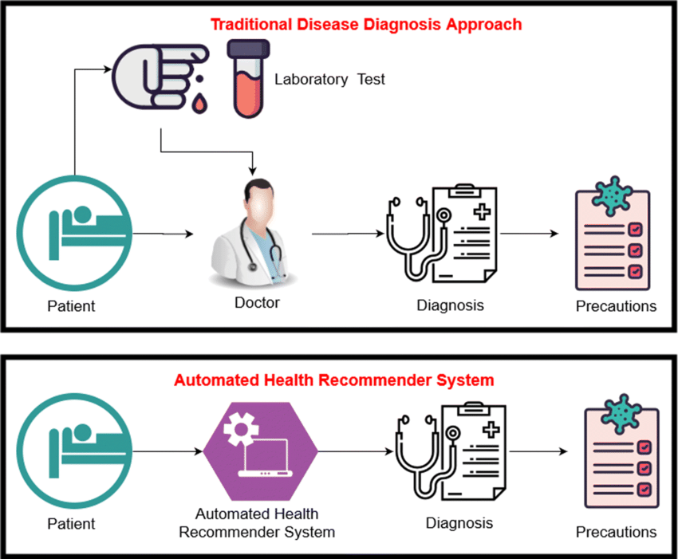
PROPOSED SYSTEM
ARCHITECTURE
.

Slide 10
HARDWARE REQUIREMENTS
Processor: Depends on model complexity.
RAM: At least 4 GB recommended.
Storage: Minimal for code and models.

Slide 11
SOFTWARE REQUIREMENTS
Operating System: Not specified
Languages Used: Python
Tools: Streamlit, pickle
Platform: Visual studios

Slide 12
EXPLANATION OF PROPOSED WORK
The proposed system of the project likely involves the development of a web application that allows users to input various health-related parameters, and based on machine learning algorithms, predicts the likelihood of multiple diseases.
The first step involves gathering a diverse dataset containing information about patient’s symptoms, lab test results, etc. This dataset should cover multiple diseases to enable accurate predictions.
Once the data is collected, it needs to be cleaned and preprocessed. This involves handling missing values, encoding categorical variables, scaling numerical features, and possibly performing feature engineering to extract relevant information.

Slide 13
EXPLANATION OF PROPOSED WORK
Streamlit is a popular Python library used for building interactive web applications. The machine learning model is integrated into a Streamlit application, allowing users to interactively input their health parameters.
Users input their health parameters into the web application, and the machine learning model processes this input to predict the likelihood of various diseases.
Once the application is developed and tested, it can be deployed on a web server.

Slide 14
ADVANTAGES OF PROPOSED SYSTEM
Accessibility
User-Friendly Interface
Real-Time Predictions
Customization
Scalability

Slide 15
Results and Discussion
Present a summary of the performance metrics for the machine learning models utilized in the project. This could include accuracy, precision, recall, F1-score, and ROC-AUC scores for each disease prediction.
Compare the performance of different machine learning algorithms used for disease prediction. Discuss the strengths and weaknesses of each approach.
Address any challenges encountered during the project, such as data availability, model complexity, or interpretability issues.

Slide 16
Results and Discussion
Discuss the most important features identified by the machine learning models for each disease prediction. This provides insights into the factors contributing most significantly to disease occurrence.
Evaluate the usability and effectiveness of the Streamlit interface in facilitating disease prediction. Discuss the feasibility and accuracy of real-time predictions using the Streamlit interface.
Discuss the potential clinical utility of the disease prediction tool developed in this project. Consider how it could be integrated into healthcare systems and its impact on patient outcomes.
By structuring the results and discussions in this manner, you can provide a comprehensive overview of the project's findings, implications, and potential avenues for further research and development.

Slide 17
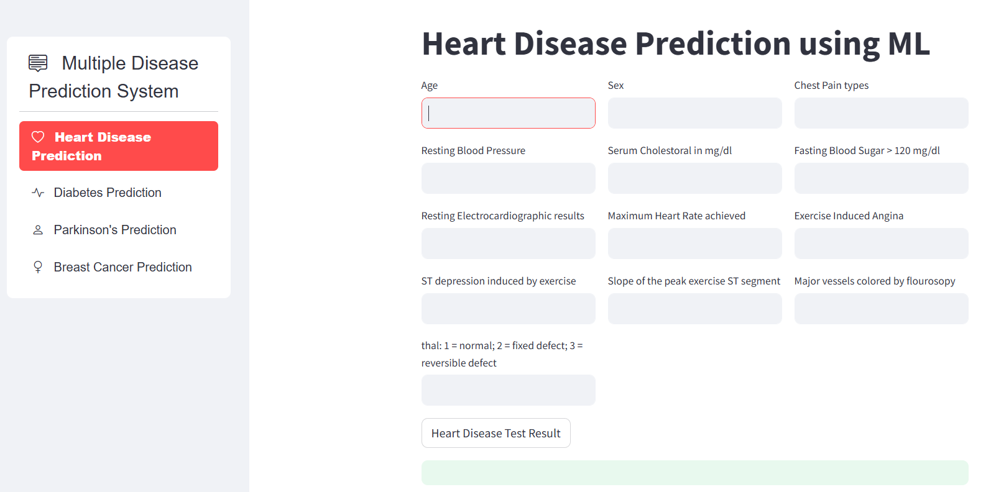
Results and Discussion

Slide 18
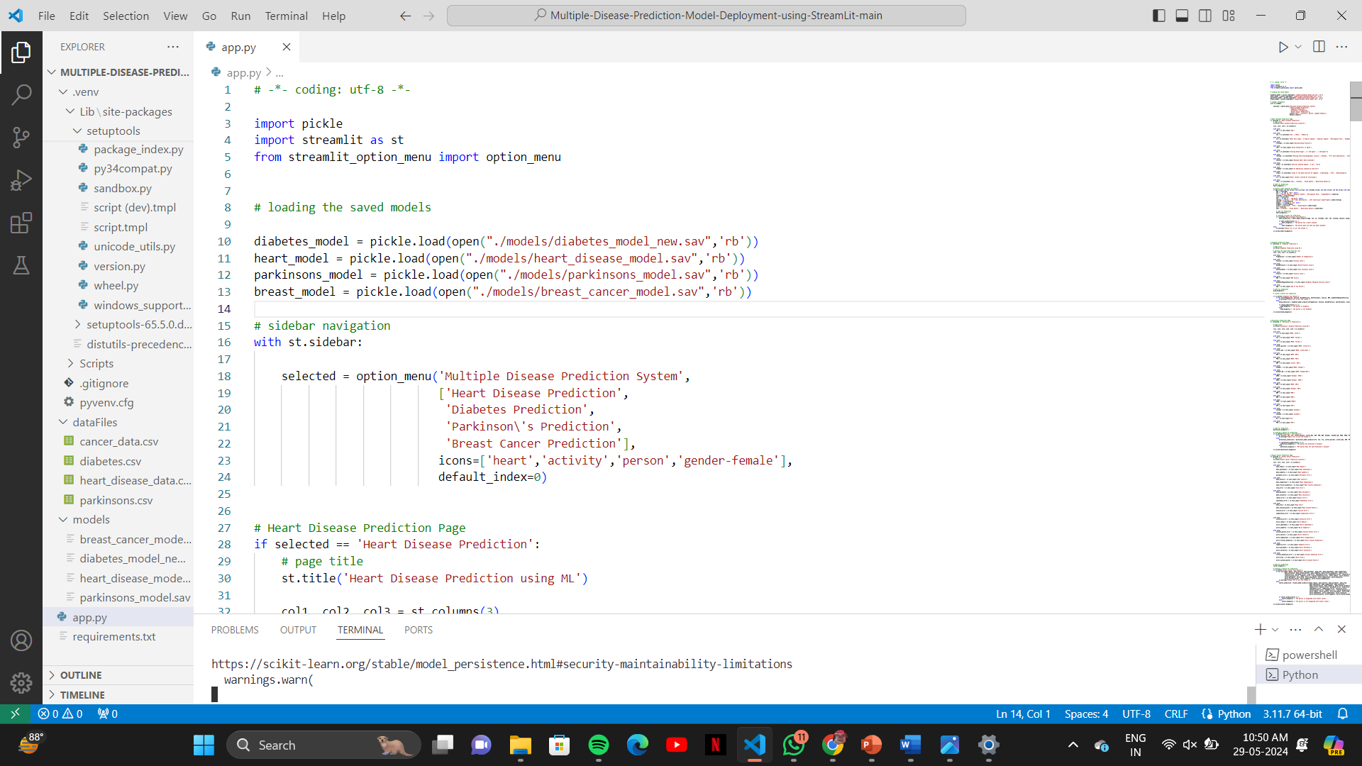
Sample code

Slide 19
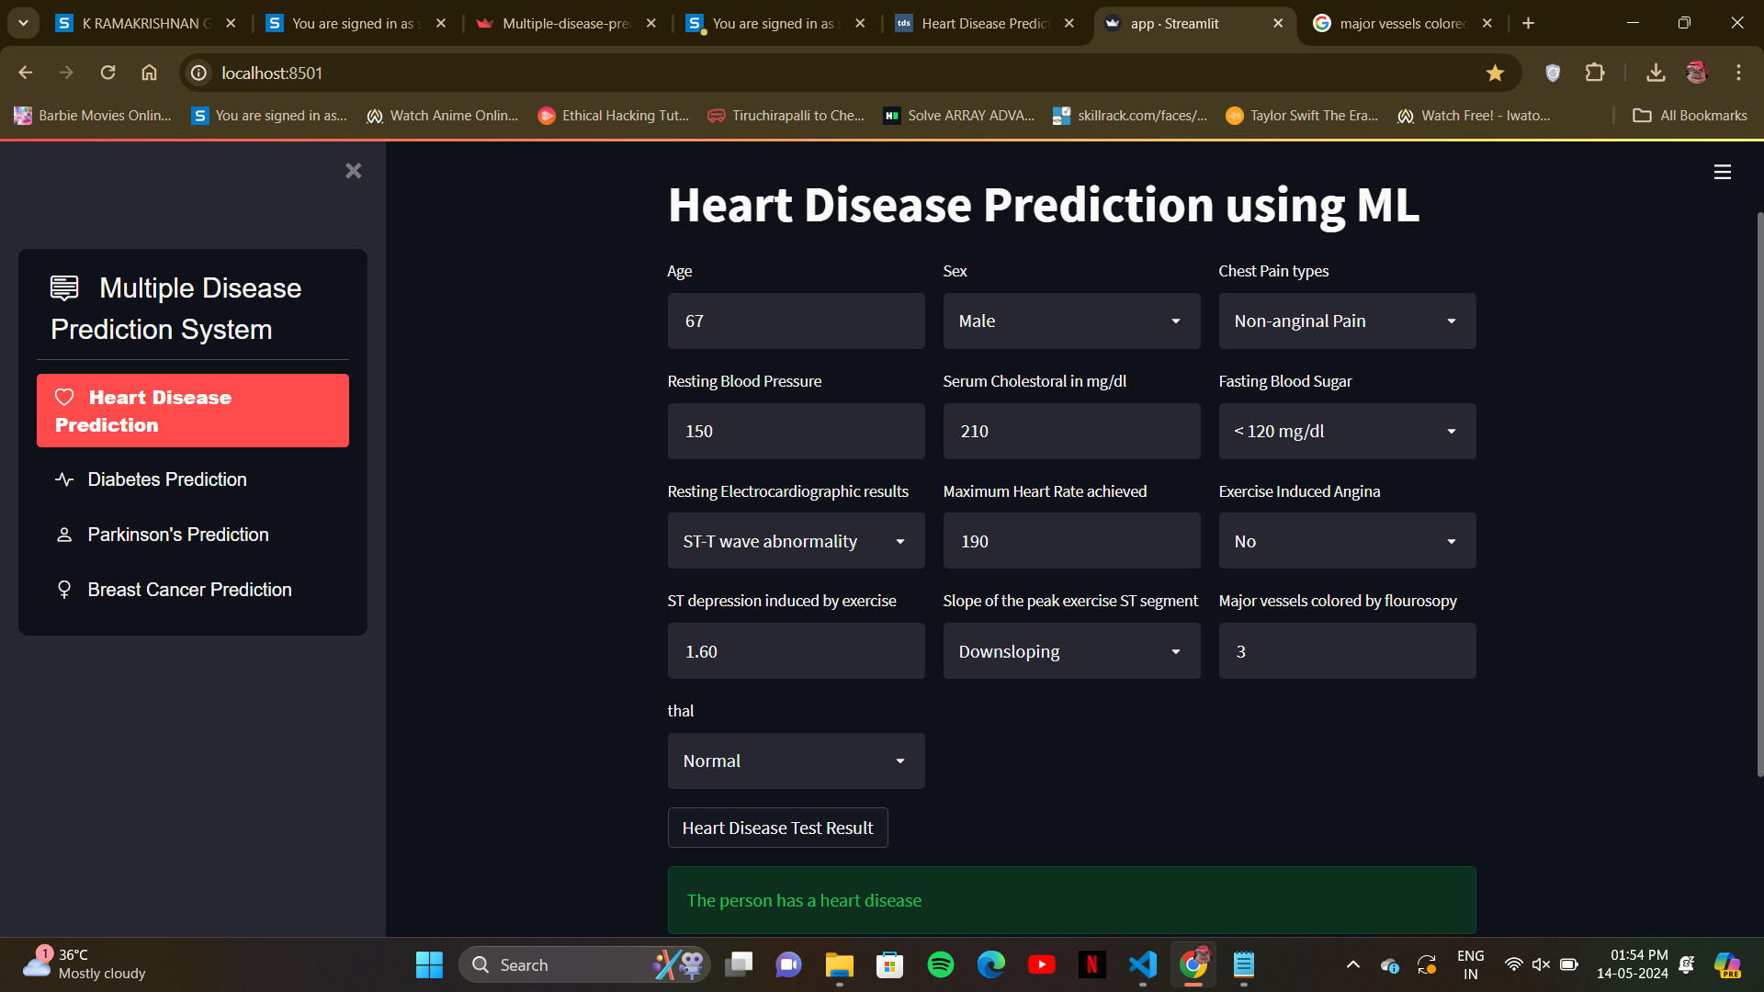
Demo and Execution

Slide 20
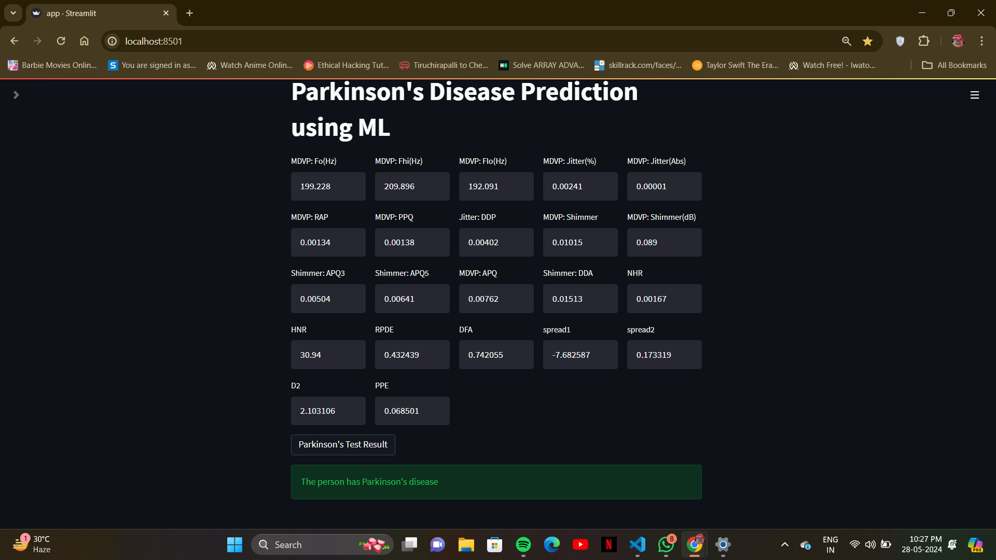
Demo and Execution

Slide 21
Conclusion
In summary, the project successfully combines machine learning with Streamlit to create an interactive platform for predicting multiple diseases, showcasing the potential for technology to revolutionize healthcare delivery.
Through the implementation of Streamlit, the project has provided an intuitive and interactive platform for users to input their data and obtain predictions for various diseases efficiently.
Moving forward, continued research and development in this field hold the promise of further refining predictive models, expanding the range of diseases covered, and enhancing the user experience.

Slide 22
THANK YOU

